Slide 1

Internship Project Presentation
On
Fraud Detection
Presented By:
1.Khushi(88)
2.Mahini Boro(101)
3.Anjali Rajput(017)

Slide 2
INTRODUCTION
Overview:
Fraud detection is a critical challenge in the financial industry, where fraudulent activities lead to significant monetary losses. Machine learning provides an effective approach to automate fraud detection by analyzing patterns in transaction data.
Objective:
The goal of this project is to develop a machine learning model capable of accurately identifying fraudulent transactions in a real-world dataset.

Slide 3
PROBLEM STATEMENT
Context: Fraudulent financial transactions are a growing global issue, causing significant financial losses for individuals and businesses. Detecting these fraudulent transactions manually is time-consuming, error-prone, and inefficient, especially when dealing with large volumes of transaction data.
Objective: The goal of this project is to develop a machine learning model that can automatically detect fraudulent transactions in a dataset of financial transactions. The model aims to identify suspicious transactions quickly and accurately to reduce financial losses.

Slide 4
APPROACH
Data Preprocessing:
Cleaned and prepared the dataset by handling missing values, encoding categorical variables, and normalizing numerical features to improve model performance.
Addressed the class imbalance problem using undersampling.
Exploratory Data Analysis (EDA):
Analyzed the data distribution using visualizations such as pie charts to show the proportion of fraudulent vs. legitimate transactions and other graphs to understand feature relationships.
Performed data profiling to identify patterns, outliers, and correlations.
Feature Engineering:
Applied linear correlation techniques to identify important features that are highly correlated with fraud, and reduced dimensionality by selecting key features.
Model Training:
Split the dataset into training and testing sets and applied machine learning algorithm Logistic Regression.
Model Evaluation:
Evaluated the model’s performance using metrics such as accuracy, precision, recall, and F1-score to ensure it effectively detects fraud without generating too many false positives.

Slide 5
Work Experience
Participated in a summer internship focusing on Python Machine Learning.
Collaborated on a credit card fraud detection project using Python.
Handled data preprocessing, visualization, and model training.
Created visualizations using Matplotlib and Seaborn to identify patterns in legitimate and fraudulent transactions.
Analysed the dataset to show linear correlations and selected relevant features for model training.
Built and trained a Machine Learning model to classify fraudulent transactions.

Slide 6
Work Outcome
Successfully identified key features influencing credit card fraud detection.​
​
Achieved a precision score of 0.9, indicating high accuracy in predicting fraudulent transactions.​
​
Enhanced the understanding of data visualization techniques and model evaluation in Python ML.​
​
Contributed to a working fraud detection model that can be applied in real-world scenarios for financial security.

Slide 7
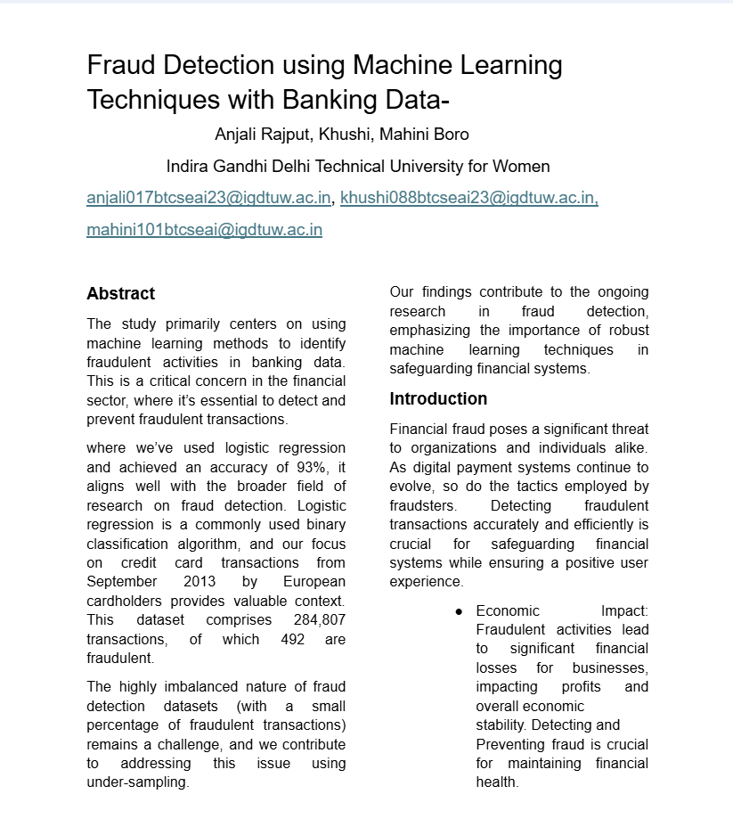
Research
PAPER

Slide 8

Internship Certificate

Slide 9


Slide 10


